Slide 1


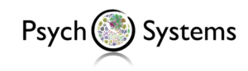
Bayesian Graphical Modeling
Theory
PSYNETS, July 2025
m.marsman@uva.nl
bayesiangraphicalmodeling.com

Slide 2




Session setup
Part I: Theory
Part II: Tutorial
Part III: Practical
image: Flaticon.com

Slide 3
Session setup
Part I: Theory
image: Flaticon.com

Slide 4
Two fundamental questions in network analysis
1
2
3

Slide 5
Two fundamental questions in network analysis
Is there an effect?
1
1
2
3
2
3

Slide 6
Two fundamental questions in network analysis
1
1
Is there an effect?
1
2
3
2
3
1
1
2
3
2
3
2
3
What is the effect?

Slide 7
Two fundamental questions in network analysis
1
1
Is there an effect?
1
2
3
2
3
1
1
2
3
2
3
2
3
What is the effect?

Slide 8
A network of alcohol disorder symptoms
emotional
problems
time
spent
work
problems
tolerance
dangerous
activities
setting
limits

Slide 9
A network of alcohol disorder symptoms
Why is the edge missing?
emotional
problems
time
spent
work
problems
tolerance
dangerous
activities
setting
limits

Slide 10
A network of alcohol disorder symptoms
Why is the edge missing?
emotional
problems
time
spent
work
problems
tolerance
Two possible explanations:
dangerous
activities
setting
limits

Slide 11
A network of alcohol disorder symptoms
Why is the edge missing?
emotional
problems
time
spent
work
problems
tolerance
Two possible explanations:
Too little information.
dangerous
activities
setting
limits

Slide 12
A network of alcohol disorder symptoms
Why is the edge missing?
emotional
problems
time
spent
work
problems
tolerance
Two possible explanations:
Too little information.
True absence.
dangerous
activities
setting
limits

Slide 13
Two take-home messages
Network estimation is insufficient to determine whether an edge should be included or excluded.
emotional
problems
time
spent
work
problems
tolerance
Inclusion tests need to distinguish between evidence of absence and absence of evidence.
dangerous
activities
setting
limits

Slide 14
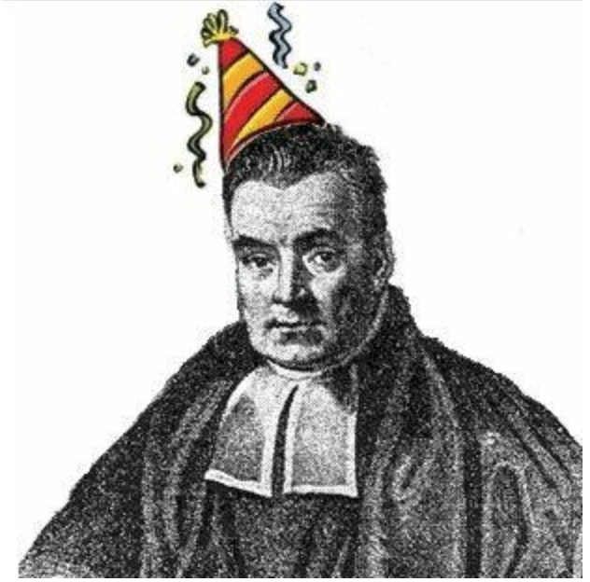
Two take-home messages
Network estimation is insufficient to determine whether an edge should be included or excluded.
emotional
problems
time
spent
work
problems
tolerance
Inclusion tests need to distinguish between evidence of absence and absence of evidence.
dangerous
activities
setting
limits

Slide 15
Bayesian Inference in a Nutshell
A method of probabilistic reasoning that updates beliefs (probabilities) as new evidence (data) becomes available.
Believed to be developed by Thomas Bayes, an 18th-century English church minister. His work was later mathematically formalized and expanded by Pierre-Simon Laplace, who applied it more broadly in probability theory.
Bayesian methods have been used broadly, from science and medicine to cracking the German naval Enigma messages during WWII.

Slide 16
The Bayesian analysis of network structures
Evaluate the predictive success of the network structure.

Slide 17
The Bayesian analysis of network structures
Evaluate the predictive success of the network structure.
But which structure?

Slide 18
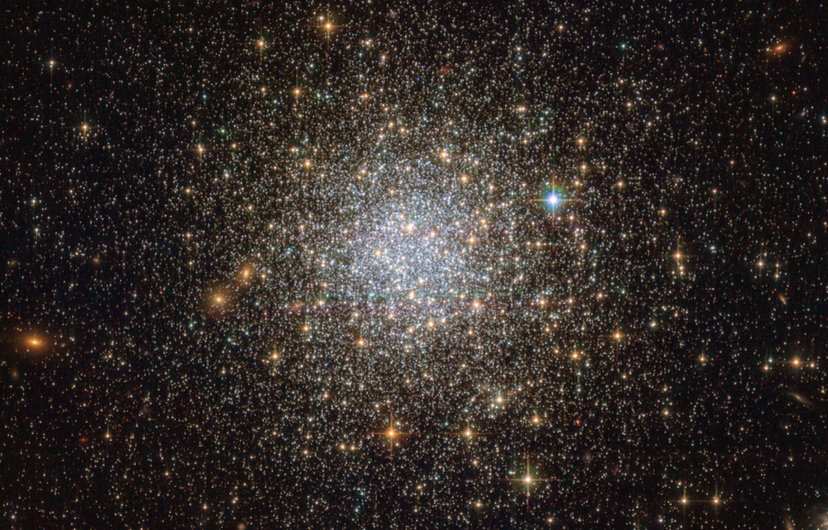
The Bayesian analysis of network structures
Evaluate the predictive success of the network structure.
But which structure?

Slide 19
The Bayesian analysis of network structures
Evaluate the predictive success of the network structure.
But which structure?
1
2
3
4
1
1
1
1
2
3
2
3
2
3
2
3
1
1
1
1
2
3
2
3
2
3
2
3
5
6
7
8

Slide 20
The Bayesian analysis of network structures
Evaluate the predictive success of the network structure.
But which structure?
1
2
3
4
1
1
1
1
2
3
2
3
2
3
2
3
1
1
1
1
2
3
2
3
2
3
2
3
5
6
7
8

Slide 21
The Bayesian analysis of network structures
Evaluate the predictive success of the network structure.
But which structure?
1
2
3
4
1
1
1
1
2
3
2
3
2
3
2
3
1
1
1
1
2
3
2
3
2
3
2
3
5
6
7
8

Slide 22
The Bayesian analysis of network structures
Evaluate the predictive success of the network structure.
We assign prior weights (probabilities) to the possible structures to reflect our uncertainty about the true structure.

Slide 23
The Bayesian analysis of network structures
We use data to update our prior probabilities to posterior probabilities – what we know after having seen the data

Slide 24
The Bayesian analysis of network structures
We use data to update our prior probabilities to posterior probabilities – what we know after having seen the data
Data
Posterior
Prior

Slide 25
The Bayesian analysis of network structures
We use data to update our prior probabilities to posterior probabilities – what we know after having seen the data
Data
Posterior
Prior

Slide 26
The Bayesian analysis of network structures
We use data to update our prior probabilities to posterior probabilities – what we know after having seen the data
Data
Posterior
Prior

Slide 27
The Bayesian analysis of network structures
We use data to update our prior probabilities to posterior probabilities – what we know after having seen the data
Data
Posterior
Prior
Predictive Updating Factor

Slide 28
The Bayesian analysis of network structures
We use data to update our prior probabilities to posterior probabilities – what we know after having seen the data
Data
Posterior
Prior

Slide 29
The Bayesian analysis of network structures
We use data to update our prior probabilities to posterior probabilities – what we know after having seen the data
Data
Posterior
Prior

Slide 30
The prior structure probabilities
1
2
3
4
1
1
1
1
2
3
2
3
2
3
2
3
1
1
1
1
2
3
2
3
2
3
2
3
5
6
7
8

Slide 31
The prior structure probabilities
1
2
3
4
1
1
1
1
2
3
2
3
2
3
2
3
1
1
1
1
2
3
2
3
2
3
2
3
Bernoulli
Beta-Bernoulli
Stochastic Block Model
5
6
7
8

Slide 32
The prior structure probabilities
1
2
3
4
1
1
1
1
2
3
2
3
2
3
2
3
1
1
1
1
2
3
2
3
2
3
2
3
5
6
7
8

Slide 33
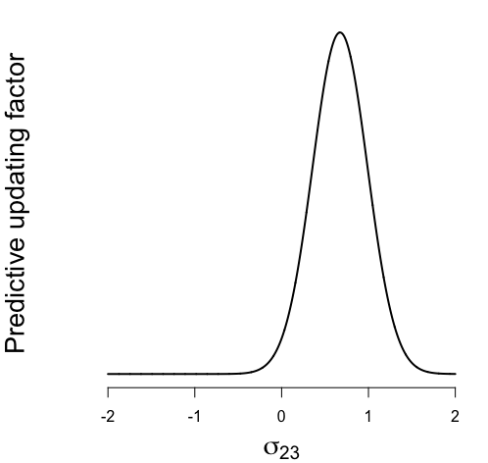
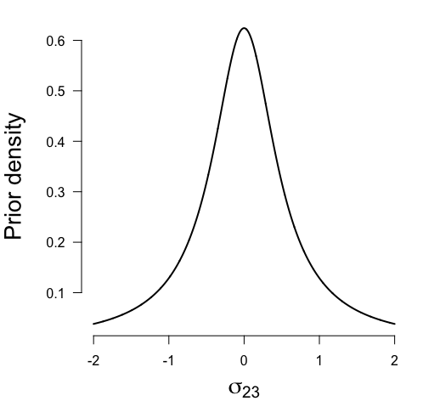
The marginal likelihood
1
2
3

Slide 34
Bayesian estimation: prior probabilities
.125
.125
.125
.125
1
1
1
1
2
3
2
3
2
3
2
3
1
1
1
1
2
3
2
3
2
3
2
3
.125
.125
.125
.125

Slide 35
Bayesian estimation: posterior probabilities
.01
.21
.10
.02
1
1
1
1
2
3
2
3
2
3
2
3
1
1
1
1
2
3
2
3
2
3
2
3
.17
.32
.05
.12

Slide 36
Bayesian estimation: posterior probabilities
.01
.21
.10
.02
1
1
1
1
2
3
2
3
2
3
2
3
1
1
1
1
2
3
2
3
2
3
2
3
.17
.32
.05
.12

Slide 37
Bayesian estimation: posterior probabilities
.01
.21
.10
.02
1
1
1
1
2
3
2
3
2
3
2
3
1
1
1
1
2
3
2
3
2
3
2
3
.17
.32
.05
.12

Slide 38
Bayesian hypothesis testing

Slide 39
Bayesian hypothesis testing

Slide 40
Bayesian hypothesis testing

Slide 41
Bayesian hypothesis testing: prior odds
.125
.125
.125
.125
1
1
1
1
2
3
2
3
2
3
2
3
1
1
1
1
2
3
2
3
2
3
2
3
.125
.125
.125
.125

Slide 42
Bayesian hypothesis testing: prior odds
.125
.125
.125
.125
1
1
1
1
2
3
2
3
2
3
2
3
1
1
1
1
2
3
2
3
2
3
2
3
.125
.125
.125
.125

Slide 43
Bayesian hypothesis testing: prior odds
.125
.125
.125
.125
.125
.125
.125
.125

Slide 44
Bayesian hypothesis testing: prior odds
.125
.125
.125
.125
.125
.125
.125
.125

Slide 45
Bayesian hypothesis testing: posterior odds
.01
.21
.10
.02
1
1
1
1
2
3
2
3
2
3
2
3
1
1
1
1
2
3
2
3
2
3
2
3
.17
.32
.05
.12

Slide 46
Bayesian hypothesis testing: posterior odds
.01
.21
.10
.02
.17
.32
.05
.12

Slide 47
Bayesian hypothesis testing: posterior odds
.01
.21
.10
.02
.17
.32
.05
.12

Slide 48
Bayesian hypothesis testing: Bayes factor
The data are 4.6 times more likely under structures that include an edge between variables 1 and 2!

Slide 49
Bayesian hypothesis testing: Bayes factor
Evidence of presence
Evidence of absence
Weak evidence

Slide 50
Quiz: Why are edges missing?
emotional
problems
time
spent
work
problems
tolerance
dangerous
activities
setting
limits

Slide 51
Solution: Evidence plot
Absence of evidence
Evidence of absence
emotional
problems
emotional
problems
time
spent
time
spent
work
problems
work
problems
tolerance
tolerance
dangerous
activities
setting
limits
setting
limits
dangerous
activities

Slide 52

End of Part I
Part I: Theory
Part II: Tutorial
image: Flaticon.com

